Slide 1
The Source of TRUF
November Inflation Review
Inflation continuing to accelerate
December 9th, 2024

Slide 2
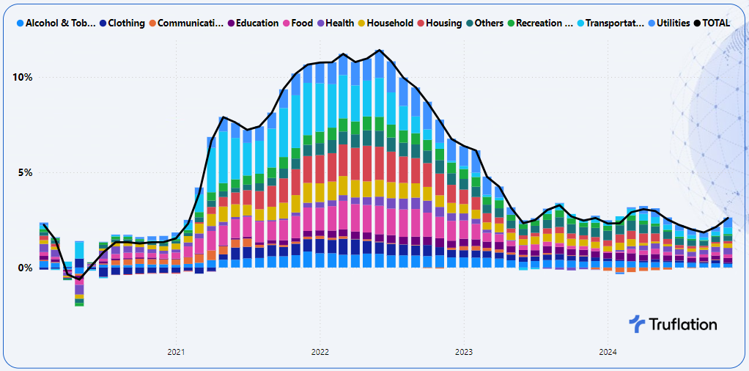
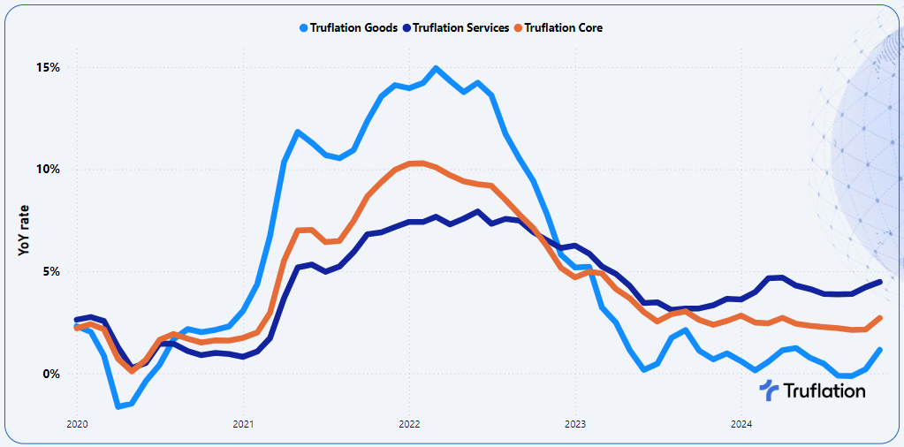
Inflation isn’t abating and continuing to build
Market forecasts are between 2.6% and 2.8%
Core is the driving force up to 2.7% YoY
Although services is strong, growth is driven by goods and is supported by accelerating incomes
Key drivers include need based categories: food, utilities, health & HH durables
Longer term inflation expected to continue to accelerate as a result of the tight labor market and the wage growth fueling demand
Truflation November BLS CPI forecast: 2.7%
November Inflation Report

Slide 3
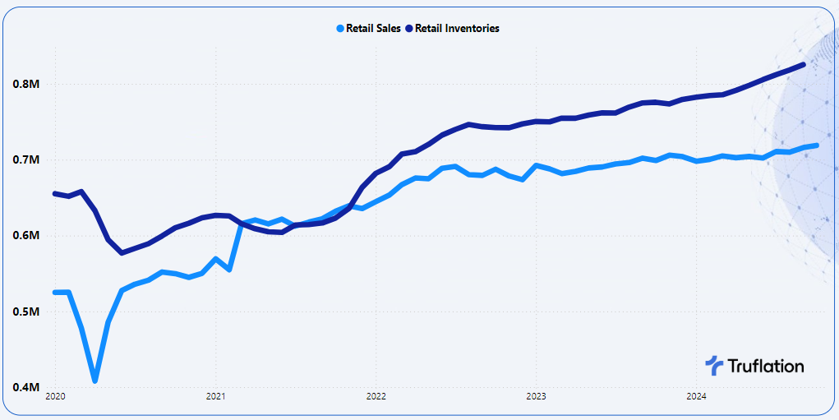
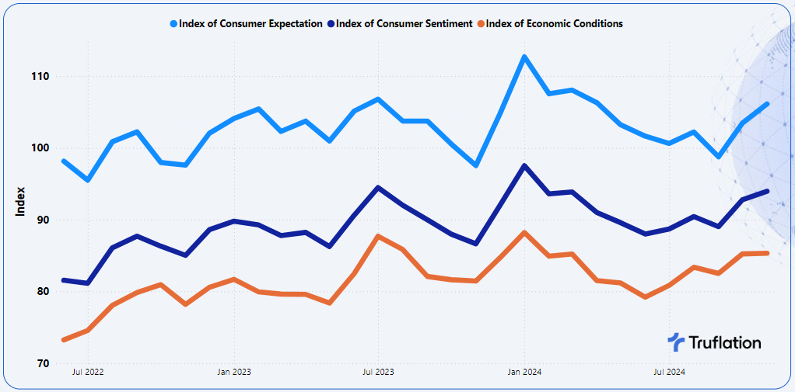
Are rate cuts over for the time being?
US Census Bureau Retail Sales in trillions of $
GDP Q4 forecast at 3.2% up from 2.8% in Q3
Consumer spending up 0.4% MoM & 5.4% YTD
Retail sales up 0.4% MoM after a strong September
Savings rate reversal and rising to 4.4%
Transition Consumer Confidence
+227k job added & unemployment rate @ 4.2%
Consumer confidence optimism continued
November Inflation Review

Slide 4
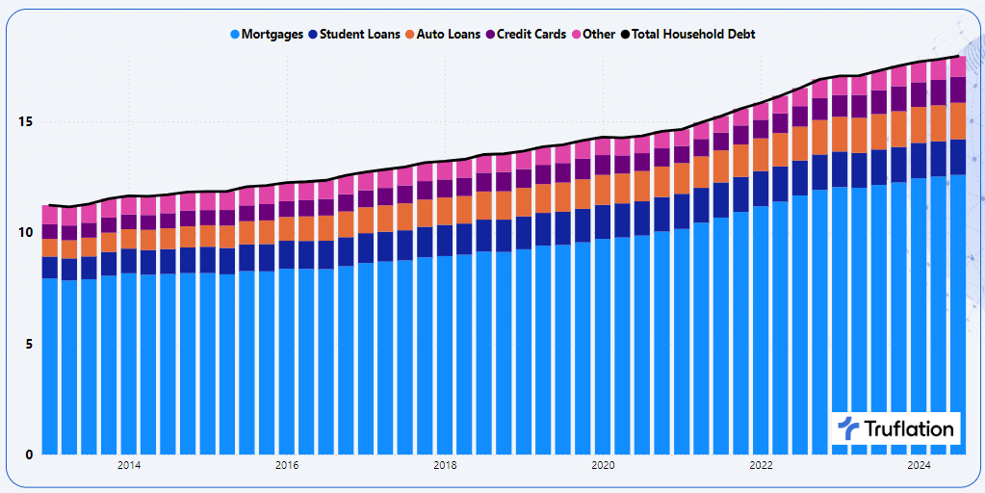
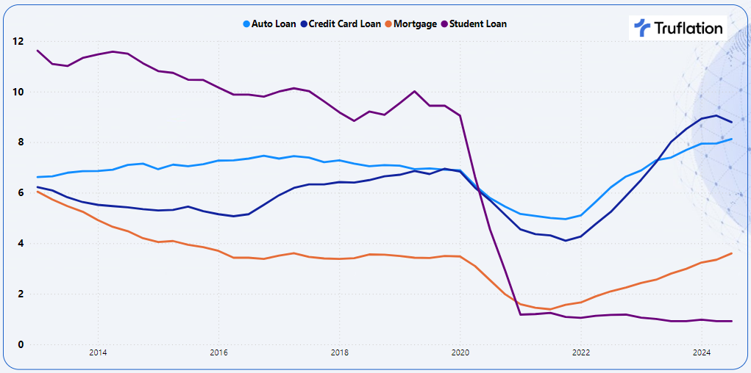
Household debt reaching another new peak
Household Debt Balances and its Composition in Trillions of $
10Th consecutive quarter of homeowners borrowed against their equity, with home equity rising $387b
Credit card balances up $24b with a record 600m accounts
Auto up $18b; Student up @21b; Mortgages up 75b
Wage pressures continuing upwards, unions key drivers
Debt risen $147b in Q3 to a new high $17.9t
Transition into Delinquency (30 days+) by Loan Type
Delinquency rates up from 3.2% to 3.5%
Student loan delinquency rates are artificially low as they aren’t reported until Q4
Credit Card delinquent balances (30+) are down 9.8 -> 8.8%
Total debt balance is at 82% of income vs 86% pre pandemic
November Inflation Review

Slide 5
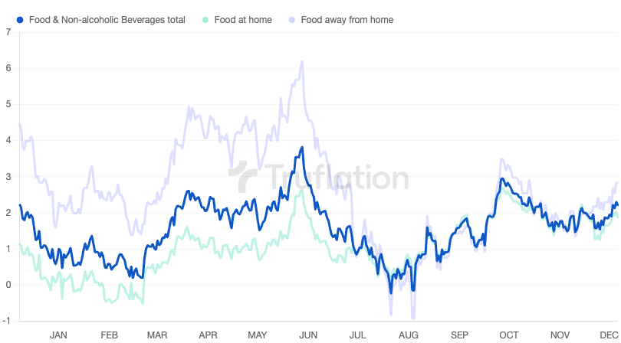
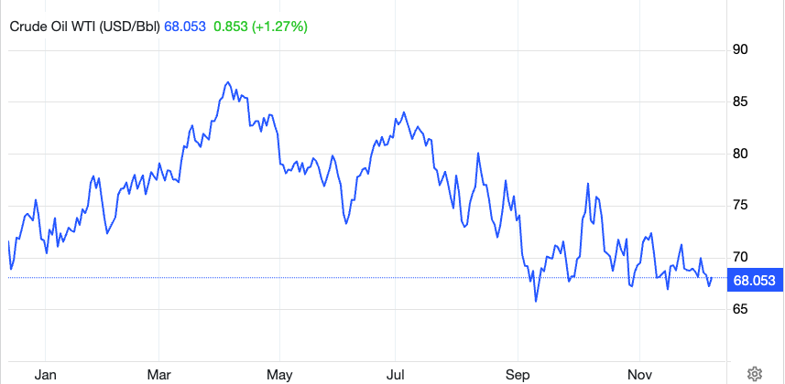
Truflation Food & Beverages Price Trends
Sector-specific Inflation Analysis
Both out of home and in home food prices showing similar trends highlights how broad based these pressures are
Food
+0.1% MoM and +2.0% YoY
Continued upward pressure; driven across the medical category
Health
+0.3% MoM and +3.5% YoY
HH Durables
Attributed to higher material costs, premiumization and inventory challenges, but consumer might be avoiding future price increases
+0.2% MoM and +2.4% YoY
Price of WTI Crude Oil per Barrel: US$ 68.08 for 9th of Dec, 2024
Housing
Owned on the rise but we might be at the bottom of the home sales with inventory up, sales up and mortgages coming down.
Rental is experiencing a decline together with hotels
-0.3% MoM and +1.4% YoY
Driven by declining gas prices. Vehicle prices continue to rise
Transportation
-0.3% MoM and +5.5% YoY
November Inflation Review

Slide 6
Persistent healthy economy will fuel demand based inflation
De-globalization; tariffs and onshoring
Q4
De-regulation; financial, energy, health & crypto
Energy prices; drill baby drill
Immigration: reducing the available labor pool
+2.8%
Tight labor market: Continued salary increase
Further rate cuts could spur demand & inflation
November Inflation Review

Slide 7
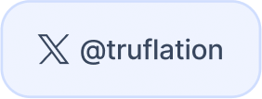
Unbelievable times
require believable data.
stefan@lagu.na
oliver.rust@lagu.na

Slide 8
Truflation forecasts of the BLS are within 0.10% on average
 | Feb 23 | Mar 23 | Apr 23 | May 23 | Jun 23 | Jul 23 | Aug 23 | Sep 23 | Oct 23 | Nov 23 | Dec 23 | Feb 24 | Mar 24 | Apr 24 | May 24 | Jun 24 | Jul 24 | Aug 24 | Sep 24 | Oct 24
Low Estimate | 5.9% | 4.9% | 4.1% | 3.9% | 2.9% | 2.7% | 3.3% | 3.5% | 3.2% | 3.0% | 3.1% | 2.6% | 2.8% | 3.2% | 3.2% | 3.0% | 2.8% | 2.5% | 2.2% | 2.4%
High Estimate | 6.2% | 5.3% | 5.0% | 4.8% | 3.4% | 3.4% | 3.8% | 3.7% | 3.4% | 3.3% | 3.4% | 3.2% | 3.5% | 3.5% | 3.5% | 3.5% | 3.1% | 2.7% | 2.4% | 2.6%
Average Estimate | 6.0% | 5.2% | 4.4% | 4.1% | 3.1% | 3.2% | 3.6% | 3.6% | 3.3% | 3.1% | 3.2% | 3.1% | 3.4% | 3.4% | 3.4% | 3.1% | 3.0% | 2.6% | 2.3% | 2.5%
BLS Actual | 6.0% | 5.0% | 4.9% | 4.0% | 3.0% | 3.2% | 3.7% | 3.7% | 3.2% | 3.1% | 3.4% | 3.2% | 3.5% | 3.4% | 3.3% | 3.0% | 2.9% | 2.5% | 2.4% | 2.6%
Truflation | 6.1% | 5.2% | 5.0% | 4.2% | 3.1% | 3.3% | 3.5% | 3.6% | 3.3% | 3.0% | 3.2% | 2.9% | 3.4% | 3.5% | 3.3% | 3.0% | 2.8% | 2.5% | 2.4% | 2.5%
November Inflation Review

